Slide 1

Vel Tech Rangarajan Dr. Sagunthala R&D Institute of Science and Technology
School of Computing
Artificial Intelligence and Data Science
10211CS224 / FULL STACK APPLICATION DEVELOPMENT (JAVA)
PROJECT REVIEW : MILESTONE PROJECT – 1
Date: 24-03-2026
REAL-TIME EVENT SYNCHRONIZATION ENGINE
Presented By:
B. BHAVESH – VTU25028– Reg.No: 23UEAD0010
Courses Handling Faculty:
Dr.K.Seethalakshmi,
M.E,Ph.D.,Associate Professor.

Slide 2
INTRODUCTION
1
In today's digital world, teams often need to work together on documents from different locations at the same time.
Traditional document editors like Notepad or MS Word do not support real-time multi-user collaboration — users must manually share and merge files.
This creates problems like version conflicts, duplicate work, and communication delays between team members.
The Real-Time Sync Engine is a web-based collaborative document editing system designed to solve these problems.
It allows multiple users to create, edit, and view documents simultaneously, with all changes reflected instantly on every screen.
The system uses WebSocket technology (SockJS + STOMP) to maintain a live two-way connection between the browser and the server.
It is built using Java Spring Boot on the backend and plain HTML/CSS/JavaScript on the frontend, with MySQL for data storage.
This project is highly relevant in the real world, as tools like Google Docs and Notion are used daily by millions of people for the same purpose.
2
3
4
5
6
7
8
9

Slide 3
PROBLEM STATEMENT
1
Most existing document editing tools are designed for individual use and do not support real-time collaboration between multiple users.
When teams work on shared documents, they face issues like editing the same file at different times, leading to version mismatch and data loss.
Traditional file-sharing methods such as email attachments and USB drives are slow, outdated, and error-prone.
There is no instant notification when a teammate makes a change, causing confusion and duplication of effort.
Existing collaboration tools like Google Docs are feature-heavy and complex — there is a need for a simpler, lightweight alternative.
Local document editors do not sync data across devices, making remote and distributed teamwork difficult.
Without a centralized system, document history and version tracking are lost, making it hard to recover data.
Therefore, there is a need for a real-time, web-based document synchronization system that allows multiple users to collaborate instantly, securely, and efficiently from any browser.
2
3
4
5
6
7
8
9

Slide 4
OBJECTIVE(S)
1
To design and develop a real-time collaborative document editing system that allows multiple users to create, edit, and sync documents simultaneously using WebSocket technology.
To implement a secure, browser-based platform with JWT authentication, instant data synchronization, and a rich set of editing features including export, dark mode, templates, and version tracking.
2
3
4
5
6
7
8
9

Slide 5
PROPOSED SYSTEM
1
The proposed system is a web-based Real-Time Sync Engine — a collaborative document editor accessible from any browser without installation.
It uses WebSocket protocol (SockJS + STOMP) to maintain a live, two-way connection between users and the server, enabling instant synchronization of all edits.
JWT-based authentication ensures that only registered and verified users can access, create, or edit documents securely.
All documents are stored in a MySQL database via Spring Boot JPA, ensuring data is saved permanently and can be retrieved anytime.
The system solves version conflict issues by broadcasting every change in real time, so all users always see the latest version of the document.
It features a rich editing interface including templates, export options (TXT, HTML, MD), dark mode, find & replace, word goal tracker, and local backup.
Unlike traditional editors, this system requires no file sharing, no manual merging, and works seamlessly for remote and distributed teams.
It is lightweight and open-source, built using free technologies (Java, Spring Boot, MySQL, HTML/CSS/JS), making it easy to deploy and extend further.
2
3
4
5
6
7
8
9

Slide 6
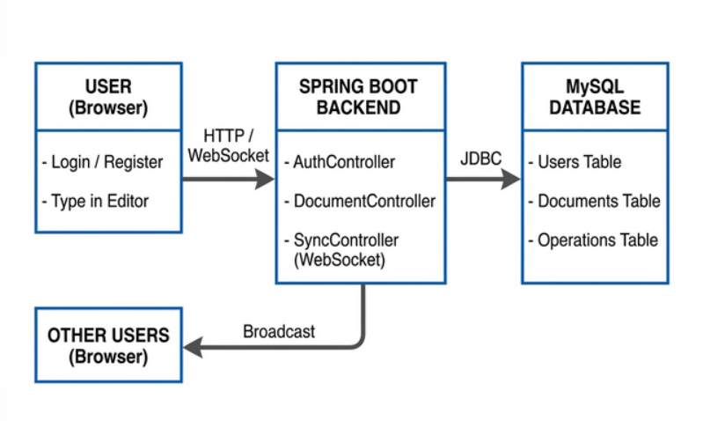
PROPOSED SYSTEM ARCHITECTURE
1
2
3
4
5
6
Input: User enters login credentials (username, email, password).
Processing: Spring Boot backend receives the input via REST API or WebSocket.
Database: MySQL stores all user accounts, documents, and document operations.
Output: The updated document content is displayed instantly on all connected browsers.
7
8
9

Slide 7
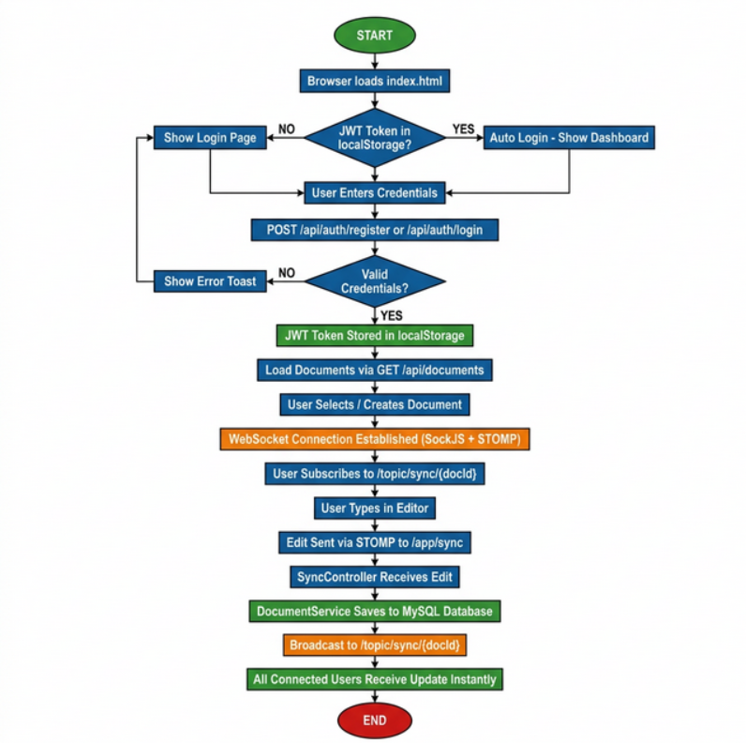
WORKFLOW
1
2
3
4
5
6
7
8
9

Slide 8
TECHNOLOGIES USED
1
Frontend: HTML5, CSS3, JavaScript (Vanilla), SockJS, STOMP.js.
Backend: Java, Spring Boot, Spring Security, Spring WebSocket, JWT (JSON Web Token), Maven.
Database: MySQL, Spring Data JPA, Hibernate.
Tools: IntelliJ IDEA / VS Code, MySQL Workbench, Git, Apache Maven, Postman.
Hardware / Software Requirements:
💻 Hardware: Minimum 4GB RAM, Intel Core i3 or above, Internet connection.
🖥️ Software: JDK 17+, MySQL 8+, Any modern web browser (Chrome, Firefox, Edge), Windows / Linux / macOS.
2
3
4
5
6
7
8
9

Slide 9
MODULE DESCRIPTION
1
Module 1: User Authentication Handles user registration and login using JWT tokens. New users are automatically registered on first login, and returning users are securely authenticated.
Module 2: Document Management Allows users to create, rename, load, and delete documents. All documents are saved to the MySQL database and listed in the sidebar.
Module 3: Real-Time Synchronization Uses WebSocket (SockJS + STOMP) to broadcast live document edits to all connected users instantly, ensuring everyone always sees the latest content.
Module 4: Editor & Toolbar Provides a rich text editing interface with features like find & replace, font size control, templates, case converter, word wrap, date insertion, and word goal tracker.
Module 5: Dashboard & Analytics Displays live statistics including total documents, total edits made, and word count of the current document via the stats panel at the bottom of the sidebar.
2
3
4
5
6
7
8
9

Slide 10
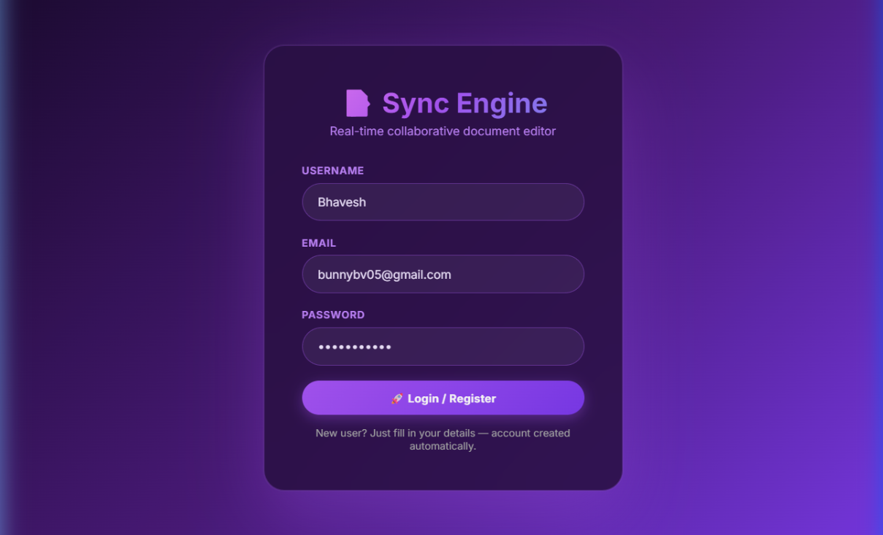
IMPLEMENTATION SCREENSHOTS
Homepage:
1
2
3
4
5
6
7
8
Explanation: The home/login page where users enter their username, email, and password. New accounts are created automatically on first login using JWT authentication.
9

Slide 11
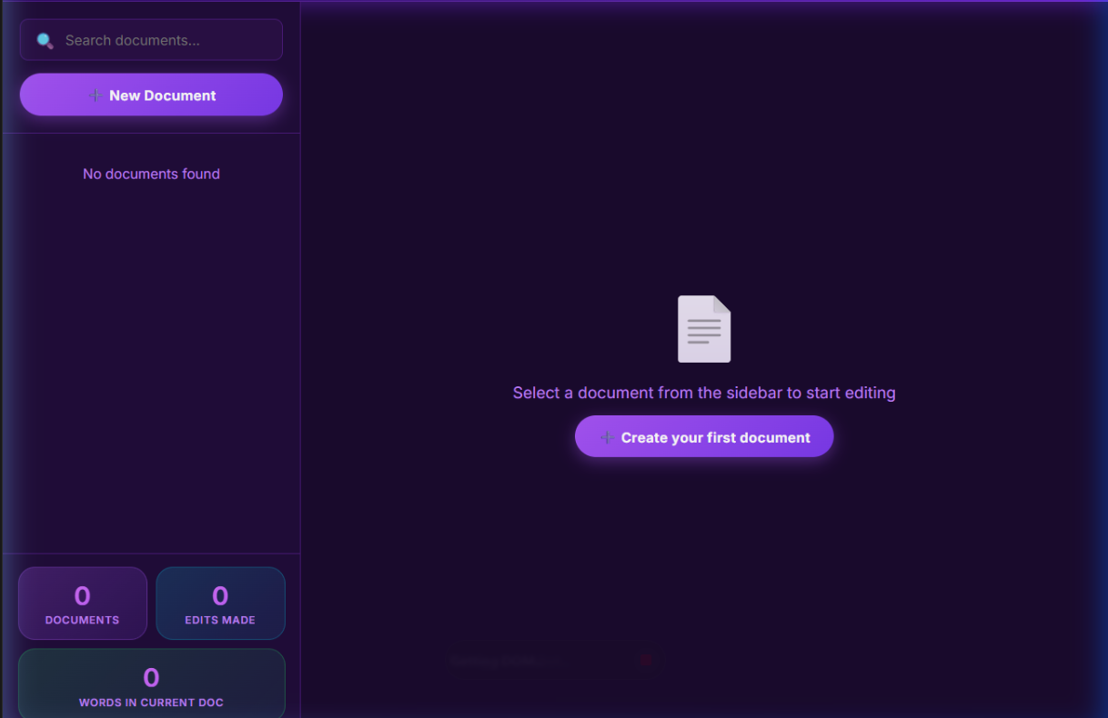
IMPLEMENTATION SCREENSHOTS
Main Module:
1
2
3
4
5
6
7
8(A)
9
Explanation: After login, the dashboard shows the document sidebar, search bar, New Document button, and live stats panel (documents, edits, word count).

Slide 12
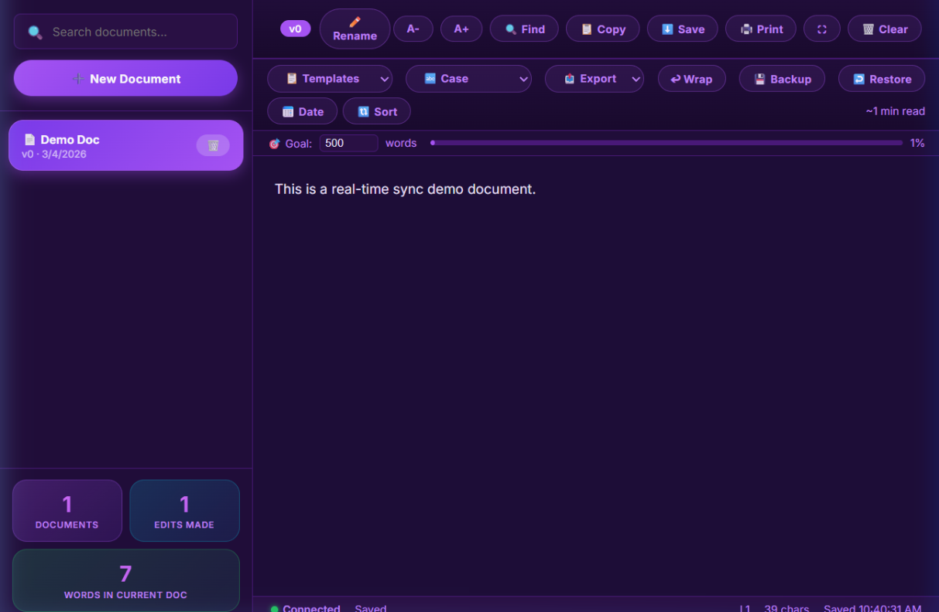
IMPLEMENTATION SCREENSHOTS
Output Page:
1
2
3
4
5
6
7
8(B)
9
Explanation: The main editor shows a live document with full toolbar (Rename, Find, Export, Print, Templates, etc.). Status bar confirms "Connected" and "Saved" in real time.

Slide 13
ADVANTAGES & LIMITATIONS
1
Real-time collaboration — Multiple users can edit the same document simultaneously without any delay using WebSocket technology.
No installation needed — Works directly in any web browser on any device without downloading any software.
Secure authentication — JWT token-based login ensures only authorized users can access and edit documents.
Feature-rich editor — Includes find & replace, dark mode, templates, export (TXT/HTML/MD), word goal tracker, and auto-save.
Internet required — The system requires a continuous internet connection and does not support offline editing.
No conflict resolution — No advanced merge logic if two users type at the exact same position at the same time.
Single server only — Currently runs on a local server and is not deployed to the cloud for public or remote access.
No user roles — All logged-in users can view and edit all documents; there is no admin, viewer, or editor role separation.
2
3
4
5
6
7
8
9

Slide 14
Thank you

